Slide 1
7.5 The cross product

Slide 2
Introduction
In this topic, we will
Discuss finding a vector orthogonal to two given vectors
Derive a general formula for finding such a vector using a system of linear equations and Gaussian elimination
See the definition of the cross product
Review the right-hand rule
Look at a means of memorizing the formula for the cross product
Look at a number of properties of the cross product

Slide 3
Finding an orthogonal vector
Given two vectors u and v, if u and v are not parallel, they define a plane
That plane has a normal vector
We want to find this normal vector
That vector will be perpendicular to both u and v
Suppose this perpendicular vector is
Thus, both these calculations must be zero:

Slide 4
Finding an orthogonal vector
This gives us two equations in three unknowns w₁, w₂ and w₃
The equations are
u₁w₁ + u₂w₂ + u₃w₃ = 0
v₁w₁ + v₂w₂ + v₃w₃ = 0
We immediately note that with two homogenous linear equations, there are infinitely many solutions
We continue by adding –v₁/u₁ times Row 1 onto Row 2:

Slide 5
Finding an orthogonal vector
How can we find the solutions for this?
One solution to 3y + 7z = 0 is to let y = –7α and z = 3α
Lets do this above:
Substituting these into Equation 1, we get

Slide 6
The cross product
Thus, we have our solutions:
We could choose any α we want, but let us choose α = 1
We will define this solution as the cross product of u and v:
Noticed if we used α = –1, the vector would still be perpendicular, but pointing in the other direction

Slide 7
The cross product
Graphically, if we have two vectors u and v
The cross product u × v will be orthogonal to both
The cross product v × u will also be orthogonal to both, but point in the opposite direction

Slide 8
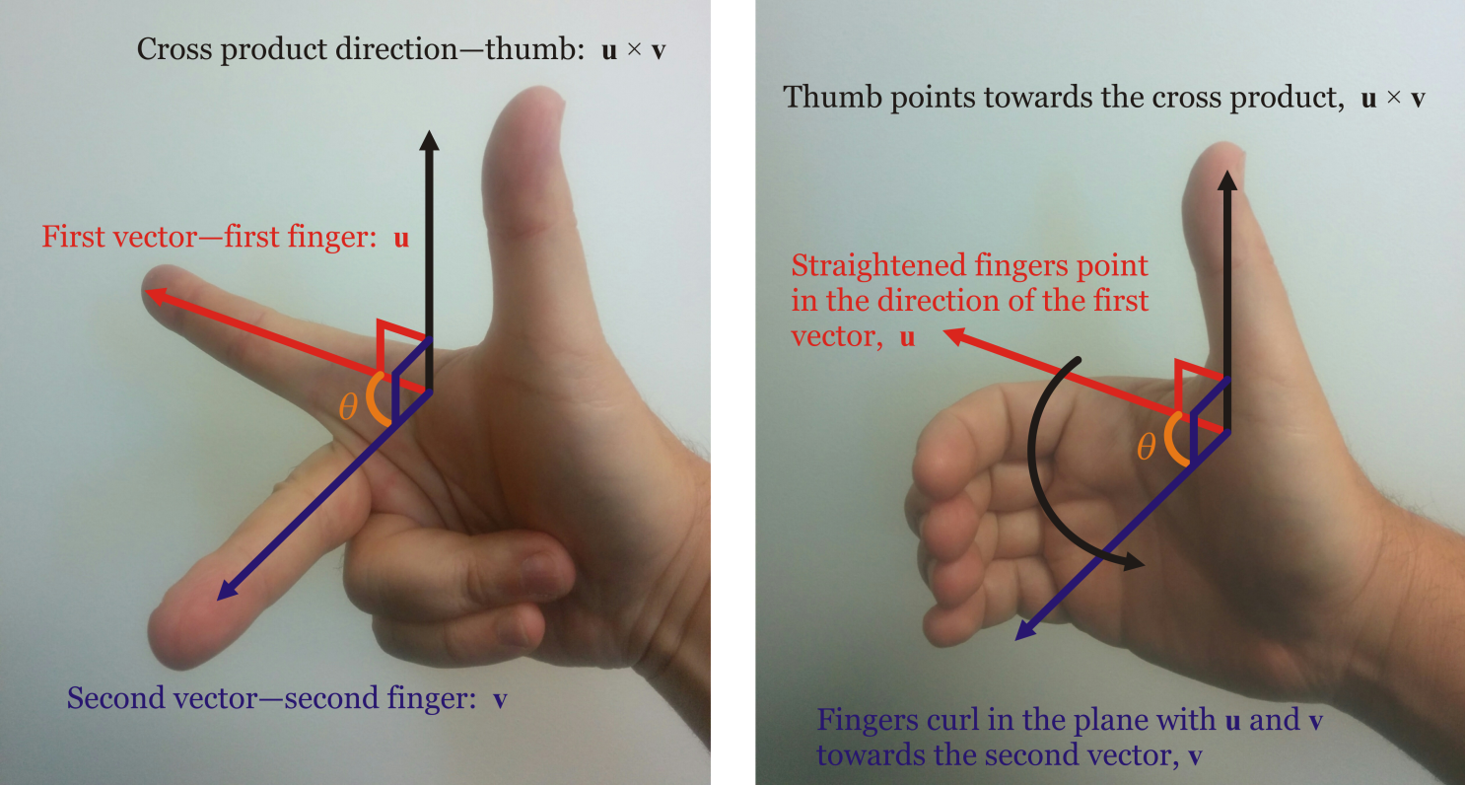
The right-hand rule
We have therefore chosen one of two orientations with
We will say that this satisfies the right-hand rule according to these rules:

Slide 9
An aide-mémoire
This is an ugly formula….
This is an easier aide-mémoire to memorize this formula

Slide 10
Example
What is the cross product of these two vectors?
0.52
2.67
0.55

Slide 11
Anti-symmetric
This is not multiplication, for with multiplication αβ = βα
Theorem
Proof:
This property is described as being anti-symmetric
Recall the real inner product is symmetric:
QED

Slide 12
Canonical basis vectors
The cross products of the canonical basis vectors are as follows:

Slide 13
Canonical basis vectors
Any cross product with the zero vector is the zero vector:

Slide 14
Bilinear
Recall for the real inner product, it is bilinear:
Theorem
The cross product is bilinear:
The proof is left to the viewer…

Slide 15
Magnitude
Recall for the real inner product,
where θ is the angle between u and v
Theorem
Proof:
The proof is in the course text, but it is nothing more than an exercise in algebra…

Slide 16
Non-associative
Recall that field addition, field multiplication and vector addition are all associative:
α + (β + γ ) = (α + β ) + γ α(βγ ) = (αβ)γ u + (v + w) = (u + v) + w
Recall also that field subtraction, field division and vector subtraction are all not associative:
α – (β – γ ) ≠ (α – β ) – γ α ÷ (β ÷ γ ) ≠ (α ÷ β) ÷ γ u – (v – w) ≠ (u – v) – w
Theorem
The cross product is not associative.
Proof:
QED

Slide 17
Observations
As the angle between u and v decreases, the magnitude of the cross product decreases
The cross product u × v is the zero vector if and only if u and v are scalar multiples of each other
If u and v are already orthonormal, then u, v and u × v for an orthonormal basis for R³

Slide 18
Summary
Following this topic, you now
Understand the purpose of the cross product
You understand how to find the cross product
Have seen an aide-mémoire for remembering the formula
Understand a number of properties about the cross product

Slide 19
References
[1] https://en.wikipedia.org/wiki/Cross_product
[2] https://en.wikipedia.org/wiki/Aide-m%C3%A9moire

Slide 20
Acknowledgments
None so far.

Slide 21
Colophon
These slides were prepared using the Cambria typeface. Mathematical equations use Times New Roman, and source code is presented using Consolas. Mathematical equations are prepared in MathType by Design Science, Inc.
Examples may be formulated and checked using Maple by Maplesoft, Inc.
The photographs of flowers and a monarch butter appearing on the title slide and accenting the top of each other slide were taken at the Royal Botanical Gardens in October of 2017 by Douglas Wilhelm Harder. Please see
https://www.rbg.ca/
for more information.

Slide 22
Disclaimer
These slides are provided for the ne 112 Linear algebra for nanotechnology engineering course taught at the University of Waterloo. The material in it reflects the authors’ best judgment in light of the information available to them at the time of preparation. Any reliance on these course slides by any party for any other purpose are the responsibility of such parties. The authors accept no responsibility for damages, if any, suffered by any party as a result of decisions made or actions based on these course slides for any other purpose than that for which it was intended.

